Slide 1
EECS 4314 Diagram used in Report

Slide 2
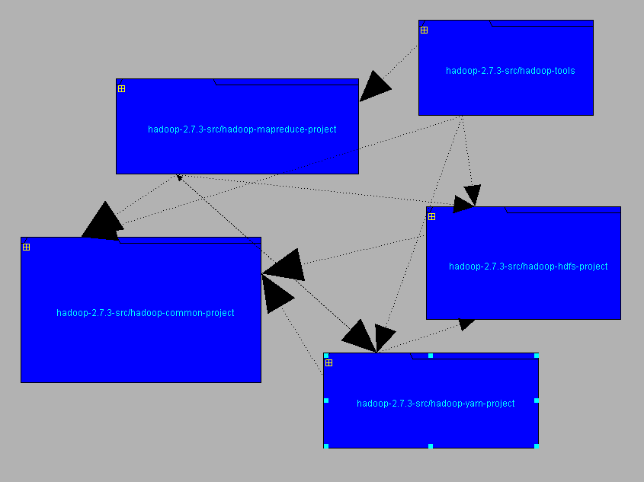

Slide 3
Apache Hadoop
MapReduce
Yarn
HDFS
Tools
Common
Main
Java
HDFS
Server
Balancer
DataNode
BlockManagement
Common
NameNode
Protocol
Legend:
Subsystem
Contained subsystem
Omitted subsystem

Slide 4
